Slide 1
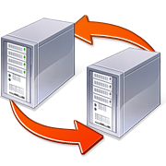
Stratos: A Network-Aware Orchestration Layer for Middleboxes in the Cloud
Aditya Akella, Aaron Gember,
Anand Krishnamurthy, Saul St. John
University of Wisconsin-Madison

Slide 2
Today’s cloud offerings
Compute and storage are first-class entities
Rich management interfaces
Easy elasticity
What about network services (middleboxes)?
Limited cloud-provided middleboxes
Third party virtual middlebox images
[Sherry et al., SIGCOMM 2012]

Slide 3
Insufficient support for middleboxes
Difficult to deploy complex functionality
Difficult to manage
Difficult to cost-effectively scale
VM
VM
App
B
VM
VM
VM
App
B
VM
App
A

Slide 4
Stratos
Network-aware orchestration layer for middleboxes in clouds
Elevates network services to a first-class entity
Exports a logical view (middlebox chains) to tenants
Performs application-specific, network-aware scaling
Minimizes network effects => ↑ utilization and ↓ cost
Requires no knowledge of/changes to middleboxes
Driven completely by software (leverages SDN)
Key to Stratos: network awareness

Slide 5
Why network awareness – I
Scale based on resource consumption
Congested link
Rack A
Rack B
App
Request backlog
Low CPU Usage
Ignoring the network → insufficient scaling

Slide 6
Why network awareness – II
Place VMs without regard to the network
App
Request backlog
Scaling doesn’t help
Ignoring the network → ineffective scaling

Slide 7
Why network awareness – III
Equally divide traffic among middleboxes
1/2 of traffic traverses inter-rack link
Rack A
Rack B
Ignoring network → over-utilized network
Network bottlenecks → spurious scaling

Slide 8
Stratos architecture
A
Stratos Controller
B
Scaling
VM Manager
Placement
470
250
360
730
680
100
Software SDN Switches
Flow Distribution

Slide 9
Stratos scaling
Based on end-to-end application performance
Implicitly compute- and network- aware
Occurs at the granularity of chains
Triggers
Scale up: ↑ chain-traversal latency OR existence of unserved demand
Scale down: ↓ request throughput AND ≈ constant chain-traversal latency

Slide 10
Stratos scaling (single chain)
Scaling trials on a chain
If ↓ Latency OR ↓ demand backlog: Keep and try another
Else: Discard and move on
Fallback: scale all
Also supports scale down and multiple chains
App Server
500 ms
400 ms
395 ms

Slide 11
Stratos architecture
A
Stratos Controller
B
Scaling
VM Manager
Placement
470
250
360
730
680
100
Software SDN Switches
Flow Distribution

Slide 12
Initial placement
k=1; done = false
While (!done):
Identify k partitions //min-K-cut
If partitions can be accommodated:
done = true
Else: k++
A
B
B
A

Slide 13
Scaled instance placement
If space with input/output VMs:
Co-locate in same rack
Else
Foreach rack i
bwc_{i} = b/w consumed if use rack i
Pick rack with min bwc_{i}
A
B
B
A

Slide 14
Stratos architecture
A
Stratos Controller
B
Scaling
VM Manager
Placement
470
250
360
730
680
100
Software SDN Switches
Flow Distribution

Slide 15
Network-aware flow distribution
Goal: minimize network effects
Triggers
Scaling (tenant-specific)
Periodically (all tenants)
Rack A
Linear Program
Input: tenant chain, incoming traffic volume, traffic ratios, placement
Minimize: overall “cost” (aggregate traffic traversing inter-rack links)
Subject to: ≈ equal load; coverage
¹/₆ of traffic (instead of ¹/₂)
Rack B

Slide 16
Implementation
Xen
domU
eth0
Stratos Controller
dom0
Open vSwitch
Floodlight

Slide 17
Implementation – tagging
Controller assigns tags to each flow
Tag identifies path through specific instances
Weighted round-robin assignment of tags to flows
Packets tagged (use DSCP bits) at ingress switch
“Interior” switches forward based on tag
App
Open vSwitch
Open vSwitch
Open vSwitch
Open vSwitch
Tag Packets
Forward based on tag

Slide 18
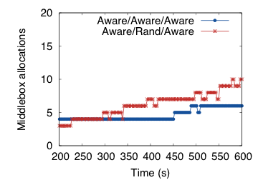
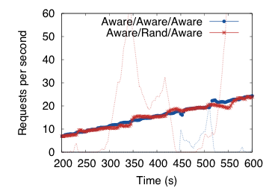
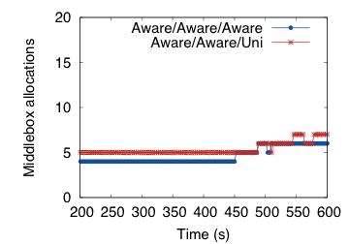
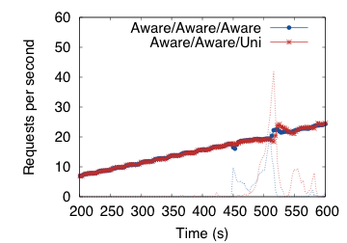
Evaluation: Placement & Distribution
Spurious scaling Unmet demand
Spurious scaling
(not pronounced)
Unmet demand

Slide 19
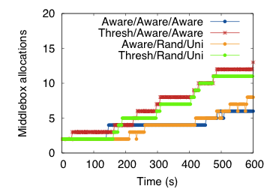
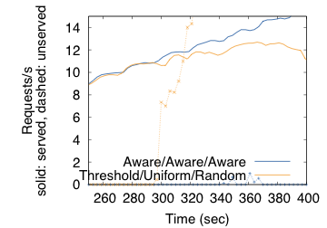
Evaluation: Scaling
A
Scaling/Placement/Distribution
Aware – ours
Thresh - CPU
Aware – ours
Rand - random
Aware – ours
Uni - uniform
Unmet demand
2X fewer

Slide 20
Stratos Summary
Network-aware orchestration layer for middleboxes in clouds
Makes middleboxes first-class citizens
Minimizes network interactions
Maximizes efficiency for tenants and providers
Driven by software-defined networking

